Slide 1
Unit 2
What time do you
go to school?
Section A Grammar Focus-3c
七年级(下)

Slide 2
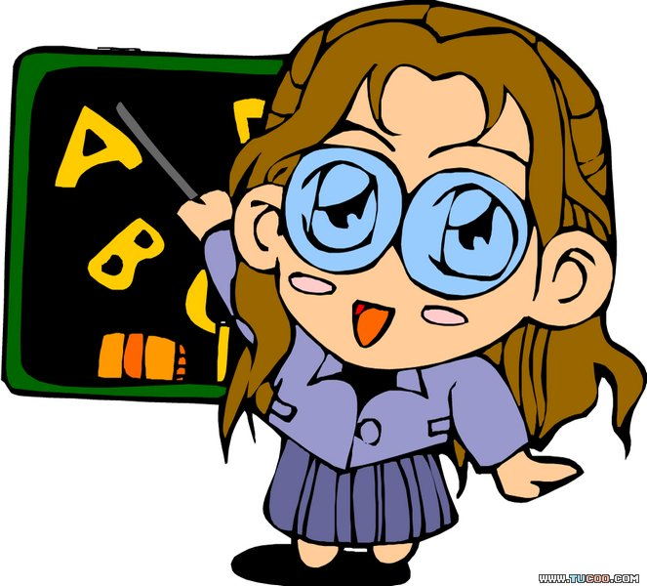
Objectives
To learn the usage of always, usually and never
To learn new words and expressions: on weekends, best, group

Slide 3
Grammar Focus
Questions | Answers
What time do you usually get up? | I usually get up at six thirty.
What time do they get dressed? | They always get dressed at seven twenty.
What time does Rick eat breakfast? | He eats breakfast at seven o’clock.
When does Scott go to work? | He always goes to work at eleven o’clock. He’s never late.
When do your friends exercise? | They usually exercise on weekends.

Slide 4
频度副词
不确定时间的副词：always（总是），often（经常）， usually（通常），sometimes（有时），seldom（很少），never（从不）等，这些副词表频度，表示经常性或习惯性的行为。
在句中位置：在be动词，情态动词或助动词之后，行为动词之前。

Slide 5
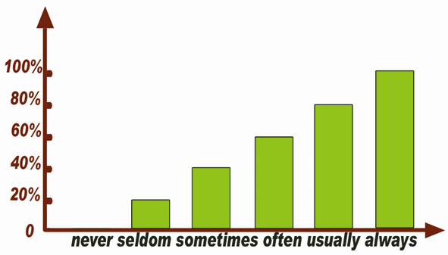
always, usually, often , sometimes, seldom, never柱状图

Slide 6
表示频度方面的区别
1. always是频度最大的词，意为“总是；永远”。
I always remember my first day at school.
我将永远记住我上学的第一天。
usually意为“通常”，即很少例外，频度仅次于always。
What do you usually have for breakfast?
你通常早餐吃什么？

Slide 7
2. often 意为“经常”,在频度上不如usually那么频繁。
Li Ping often does his homework in the afternoon.
李平经常在下午做作业。
never 从未；永不；决不。
I have never been there.
我从未到过那里。

Slide 8
3. sometimes意为“有时候”,频度比often小,表示动作偶尔发生,间断较大。既可以放在be动词、助动词之后,行为动词之前,也可以放在句首,还可以放在句尾。
I sometimes go to the library.
我有时去图书馆。
Sometimes I read a book in the evening.
我有时在晚上看书。

Slide 9
频度副词在句中的位置
频度副词在句中习惯上位于be动词之后、
行为动词之前，助动词之后。
She is often late for school.
她上学经常迟到。
He usually goes to bed at about 12.
他通常(午夜)十二点钟睡觉。
When do you usually get up in the morning?
你通常早上什么时候起床？
He never has anything to do.
他一向无所事事。

Slide 10
I often get up at five past six.
He usually plays basketball on Saturday morning.
They always help others.
You must never tell him.

Slide 11
3a Write answers or questions. Use always, usually or never.
1. What time do you get up on school days?
___________________________________
2. ___________________________________
Rick always gets up at 6:20.
3. What time do you have breakfast?
____________________________________
4. ____________________________________
Anna never eats breakfast.
5. What time does your best friend go to school?
____________________________________

Slide 12
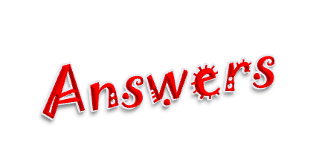
1. What time do you get up on school days?
_______________________________
2. ______________________________?
Rick always gets up at 6:20.
3. What time do you have breakfast?
___________________________________
4. ____________________________________？
Anna never eats breakfast.
5. What time does your best friend go to school?
_______________________________
I usually get up at seven o’clock.
What time does Rick usually get up
I usually have breakfast at eight o’clock.
What time does Anna usually eat breakfast
She usually go to school at six forty.

Slide 13

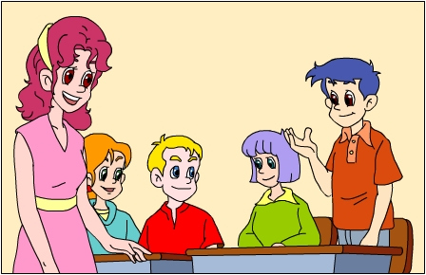
Talk about something you always do,
something you usually do, something you
never do.
S1: I always… I usually… I never…
S2: I always… I usually… I never…
S3: I always… I usually… I never…
S4: I always… I usually… I never…

Slide 14
3b Write about something you always do, something you usually do and something you never do.
always ____________________________
__________________________________
usually ____________________________
__________________________________
never _____________________________
__________________________________

Slide 15
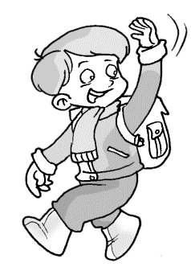
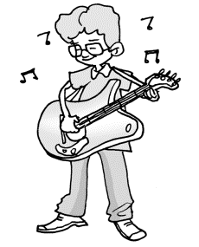
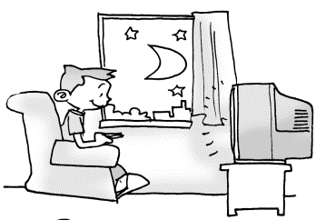
1. always
_______________________________
2. usually
____________________________________
3. never
___________________________________
I always go to school at seven o’clock.
I usually play the guitar at 6:00 after school.
I never watch TV on school days.

Slide 16
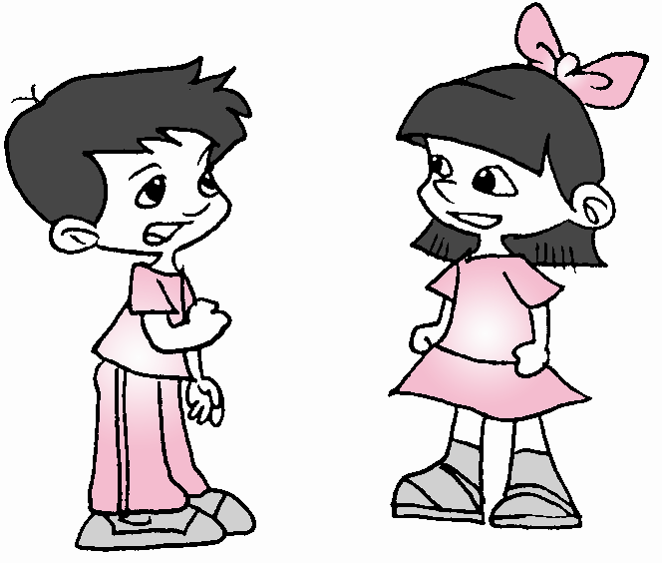

3c Interview three of your classmates.
Find out what time they do these
activities. Then give a report to
the class.
A: Hi, Li Fei. What time do you
get up on weekends?
B: I usually get up at seven o’clock.
A: What time do you exercise?
B: I usually exercise at eight o’clock.

Slide 17
A: What time do you eat dinner?
B: I usually eat dinner at six thirty.
A: What time do you take a shower?
B: I usually take a shower at nine o’clock.
A: What time do you go to school?
B: I usually go to school at seven thirty.

Slide 18
Complete what time they do these activities.
 | S1 Name: Li Fei | S2 Name:____ | S3 Name:____
get up on weekends | 7:00
exercise | 8:00
eat dinner | 6:30
take a shower | 9:00
go to school | 7:30

Slide 19

Give a report to the class.
In our group, Li Fei usually gets up late on weekends. She gets up at
____________________________________
____________________________________
____________________________________
____________________________________
___________________________
seven o’clock. She always exercises at eight o’clock. She usually eats dinner at six thirty.
She usually takes a shower at nine o’clock.
She usually goes to school at seven thirty on school days.
In our group, S2… S3…

Slide 20
Language points
1. best 最好的（地）; good的最高级
My good friend is Jack, and he’s my best friend.
杰克是我的好朋友, 并且他是我最好的朋友。

Slide 21
2. group 组，群
We have six students in our group.
我们小组里有六名学生。
3. on school days 在上学日里
on weekends 在周末

Slide 22
Quiz

Slide 23
一、选词填空
never, weekends, dressed, group, best
best
1. Who is your ____ friend?
2. Jenny and Mary always play tennis on _________.
3. Tom can play guitar well in our ______.
4. Bob _____ eats ice-cream. He thinks it’s not healthy.
5. His sister usually gets _______ at 6:00 in the morning.
weekends
group
never
dressed

Slide 24
二、翻译下列句子
1. 他上班从未迟到过。
_________________________________
2. 我弟弟总是在七点钟穿好衣服。
_________________________________ ________________
3. 在周末，我姑姑通常八点钟锻炼。
_________________________________ ____________
He’s never late for work.
My brother always gets dressed at seven o’clock.
My aunt usually exercises at 8:00 on weekends.

Slide 25
4. 在上学的日子里，他总是七点吃早饭。
_________________________________
___________
5. 在他小组里，杰克通常在十点钟冲淋浴。
_________________________________
___________________
He always eats breakfast at 7:00 on school days.
Jack usually takes a shower at ten o’clock in his group.

Slide 26
三、用适当的单词，完成对话。
time
A: Hi, Rick, What ____ do you get up?
B: I usually get up __ five thirty.
A: Wow. I _____ get up so early.
B: I like sports. I always _______ at five fifty.
A: What time do you ________ breakfast?
B: At seven twenty. Then I _____ teeth.
A: _____ do you go to school?
B: At seven forty. I’m never ___ for school.
at
never
exercise
eat/have
brush
When
late

Slide 27
Homework
If you can be free this weekend, please
design your favorite activities. According
to the content, you need to write a
composition named My Weekend.

Slide 28
Thank You!

